Slide 1
Parents’ workshop:
dealing with anxiety and stress
in primary school pupils.
lizneale11@gmail.com
07793033998
Sue.calveley@edsential.co.uk 07710706173

Slide 2
What causes anxiety and stress in our primary age pupils?
Signs of stress in children.
Strategies and resources to support our children.

Slide 3
The Facts
NSPCC figures show that mental health referral for under 11s have risen by a third in just three years. This equates to 183 referrals every school day.
It is normal for children to feel worried or anxious from time to time, but for some anxiety affects their behaviour and thoughts every day and interferes with their school, home and social life.
According to Youth UK, young people spend 6 hours a day feeling stressed or worried.
1:3 people experience Mental Health issues.

Slide 5
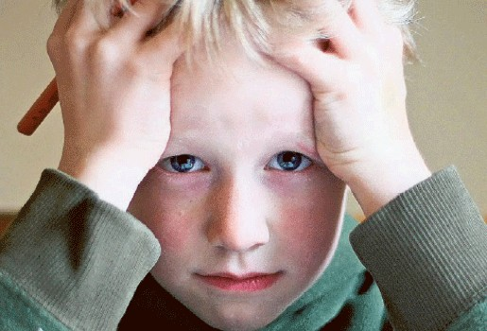
Activity 1
What’s on your child’s mind?

Slide 6
…
Common causes of anxiety
Classroom | Wider Community
Homework and perceived consequences of ‘getting it wrong’. Friendships. Collective punishment – when the teacher keeps everyone behind. Teacher volume – when the teacher shouts to reprimand, and more generally their everyday delivery voice. Getting changed for PE. Transition – Y6/Y7. | Fallout from conflicts on social media – often ‘banter’ that goes to far. Changeover – pushing etc. and noise on the corridors. ‘Being judged’ over appearance, sexuality, family background etc. Eating in front of other students. Using school toilets.

Slide 8
Anxiety

Slide 9
Types of Anxiety
Anxiety is the most common emotional problem in children. Kids can develop crippling worries about many things, from germs to vomiting to their parents dying. Some anxious kids are painfully shy, and avoid things that other kids enjoy, Some have tantrums and meltdowns, and others develop elaborate rituals, like compulsive hand washing, aimed at diminishing the fear
https://childmind.org/topics/concerns/anxiety/

Slide 10
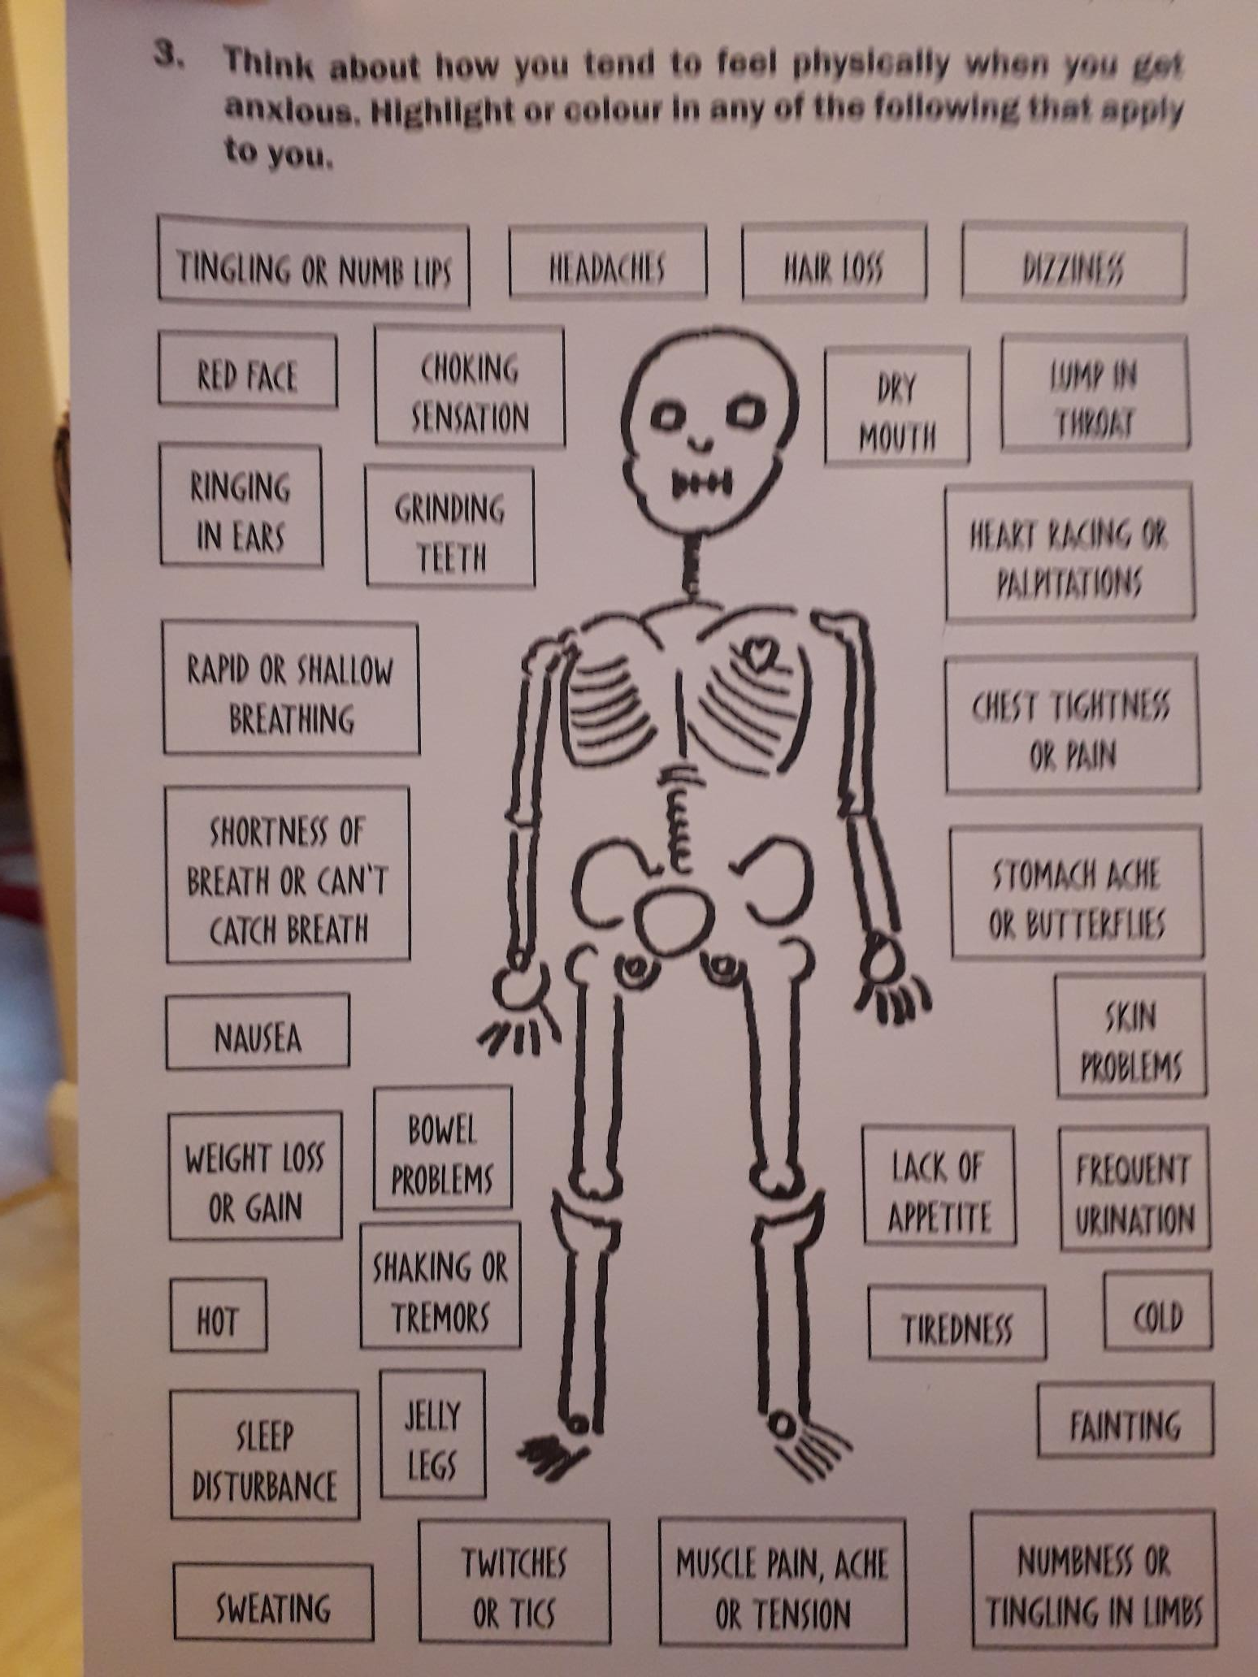
How am I feeling?

Slide 11
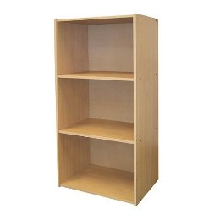
The Worry Shelf- prioritize your worries

Slide 12
Track your mood

Slide 13
Helping myself
Getting help from others

Slide 14
Balloon activity
Share your child’s worries.
Write them on a balloon and set those worries free.
This physical activity sometimes releases the child’s anxiety and stress.

Slide 15
My Stress Bucket
Notes:
Template in workbook

Slide 17
My favourite resource/ a workbook for you to share or your child to dip into.
The Unworry Book £8.99
An activity book to calm your mind
£8.99
My Hidden Chimp- Steve Peters
A child’s guide to understanding your brain. £8.68 Amazon

Slide 18
Two more favourites:

Slide 20
http://www.moodjuice.scot.nhs.uk

Slide 22
Thank you for taking the trouble to attend today,
please feel free to e mail any feedback to:
lizneale11@gmail.com
sue.calveley@edsential.co.uk

